Slide 1







X-Reporto
X-Reporto
Computer Engineering Department
Presented By:
Ahmed Hosny Ahmed Sabry
Basma Elhoseny Zeinab Moawad
Supervisor:
Dr.Yahia Zakaria
Class of 2024

Slide 2


X-Reporto
Agenda
Introduction
Denoiser
Object Detector
Classifiers
Language Model
Template Based Report
System Design
Our X-Reporto Tool
Demo

Slide 3

X-Reporto
Introduction
Semi-automated reporting tool
Generating preliminary reports for each anatomical region and produce template based report
Identifying diseases in those regions ,their locations.
Enhancing chest X-ray images to correct defects caused by the X-ray devices.

Slide 4
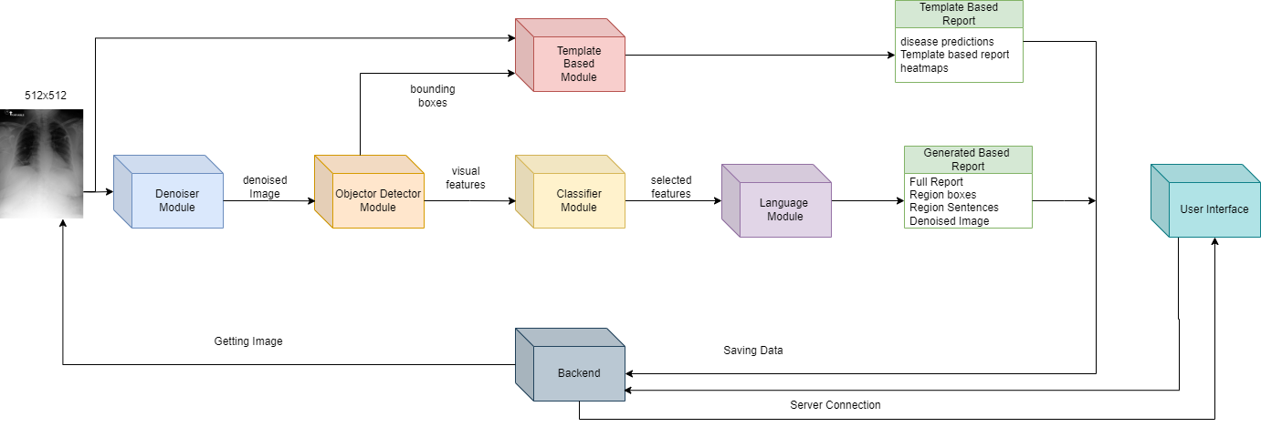
X-Reporto
Introduction

Slide 5
X-Reporto
Data Work

Slide 6

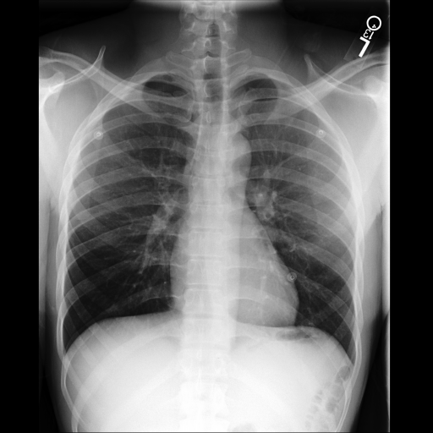
X-Reporto
Denoiser
Data Work
Extracting Data
Statistics
Preprocessing and structure

Slide 7
X-Reporto
Denoiser

Slide 8
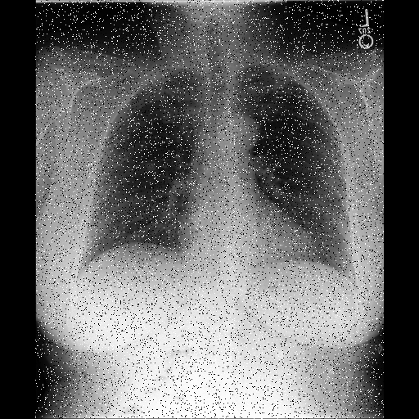
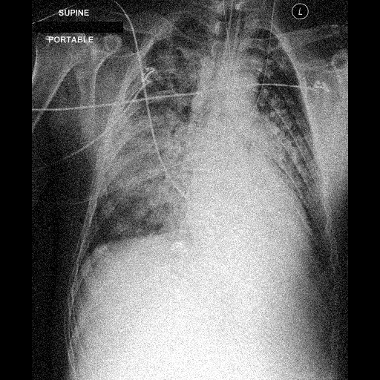
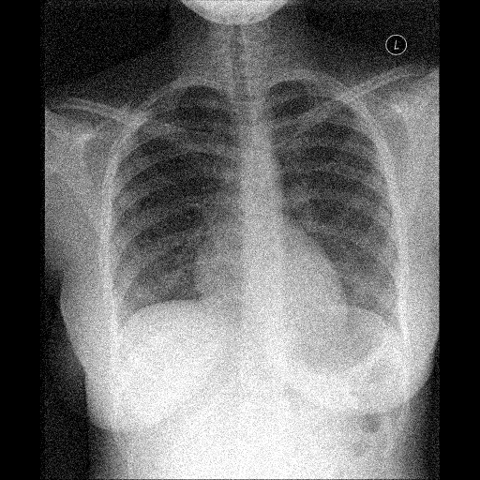
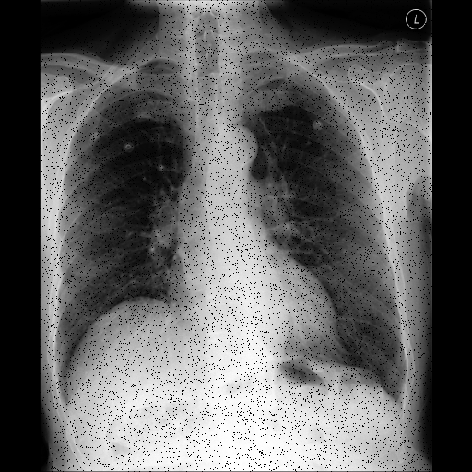
X-Reporto
Denoiser
Classical Approach
Noise Types:
Block pixel
Convolution
Keep patch
Extract patch
Pad rotate
Random noise
Line strip
Salt and pepper
no noise

Slide 9
X-Reporto
Denoiser
Classical Approach
Data generation
Resize
Padding
Noise Generation

Slide 10
X-Reporto
Denoiser
Classical Approach
Feature Extraction:
All Image
HOG
Fourier Transform
Mix Features
Classifiers:
SVM
Random Forest
Adaboost

Slide 11
X-Reporto
Denoiser
Classical Approach
Denoising:
Black Pixel ⇒ Median blur
Salt and Pepper ⇒ Median blur
Convolution ⇒ Gaussian kernel & Non-local means denoising
Random Noise ⇒ Non-local means denoising
Keep patch ⇒ Interpolation
Extract patch ⇒ Interpolation
Line Strip ⇒ Interpolation
Pad rotate ⇒ Can’t solve !!
No Noise

Slide 12
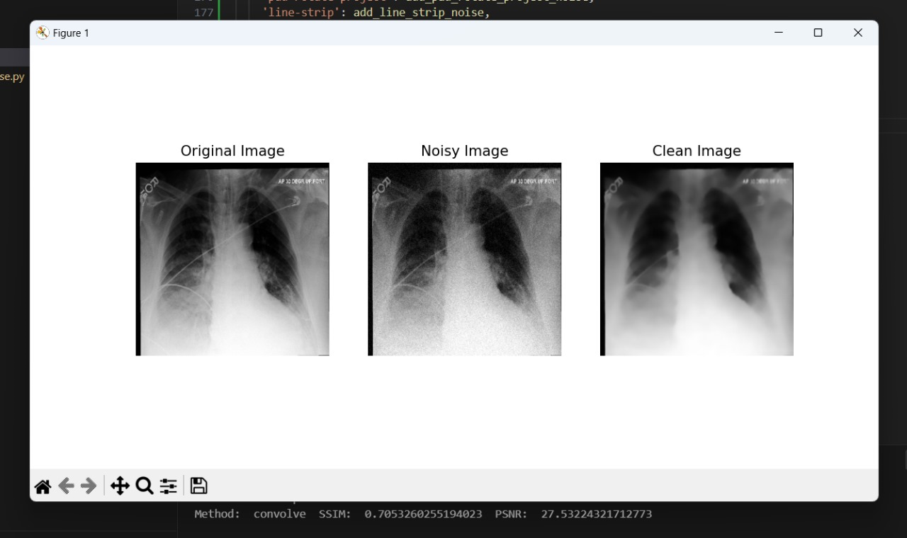
X-Reporto
Denoiser
Classical Approach
Challenges:
Convolution
High SSIM and PSNR but blurry image ⇒ lost medical information

Slide 13
X-Reporto
Denoiser
Classical Approach
Challenges:
More than one type of noise
Wrong classification

Slide 14
X-Reporto
Denoiser
Deep Learning Approach
Challenge
How to restore image and preserve
features content of image

Slide 15
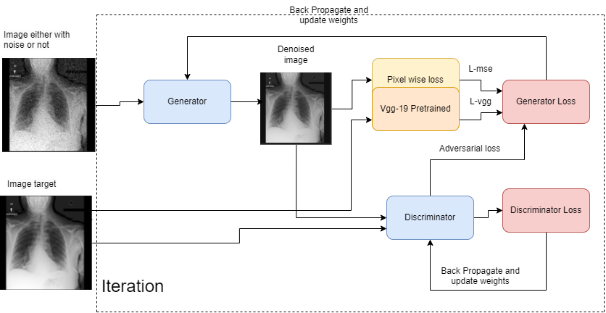
X-Reporto
Denoiser
Deep Learning Approach

Slide 16
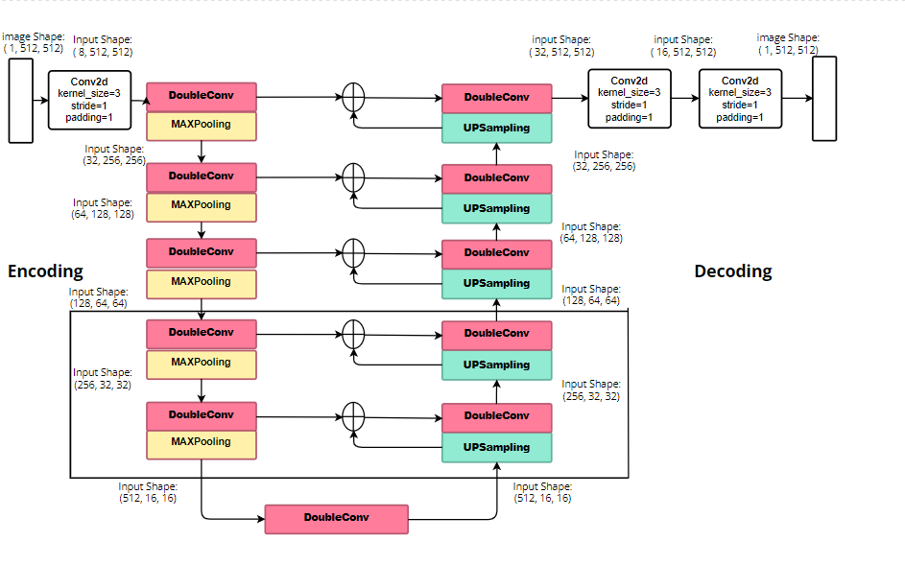
X-Reporto
Denoiser
Deep Learning Approach
Generator Architecture
There are five down-sampling layers and up-sampling layers.
All convolution layers keep the same image size.
In the down-sampling process: the feature maps are 1/32 of the original size, retaining important features.

Slide 17
X-Reporto
Denoiser
Deep Learning Approach
Generator Architecture
In the up-sampling process: bi-linear interpolation is used to expand feature maps.
Copy operations: to propagate context information to higher-resolution layers.

Slide 18
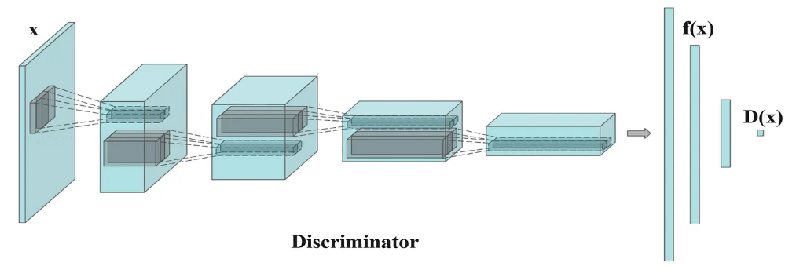
X-Reporto
Denoiser
Deep Learning Approach
Discriminator Architecture
This combination of strides helps in
preserve more spatial information and finer details in the input image.
capturing more abstract and higher-level features as the network goes deeper.
No sigmoid cross-entropy layer at the end to improve the training stability.

Slide 19
X-Reporto
Denoiser
Deep Learning Approach
Training
Loss Functions:
The discriminator ’s job remains unchanged which is Adversarial loss ladv.
Being near the ground truth output by pixel wise loss an lmse.
Perceptual losses lvgg are also used to penalize any structure that differs between output and target.

Slide 20
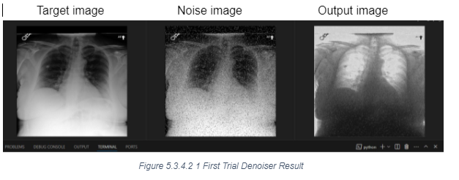
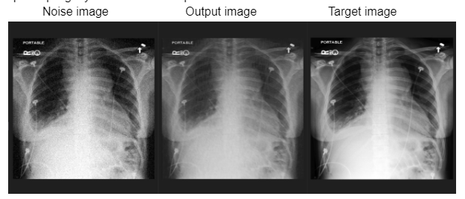
X-Reporto
Denoiser
Deep Learning Approach
Experience
5 instead of 4 downsampling layers and up-sampling layers.
Results improved as illustrated these results on 150 images of train and 50 images of test by ssim: 0.69 by 25 epoch.

Slide 21
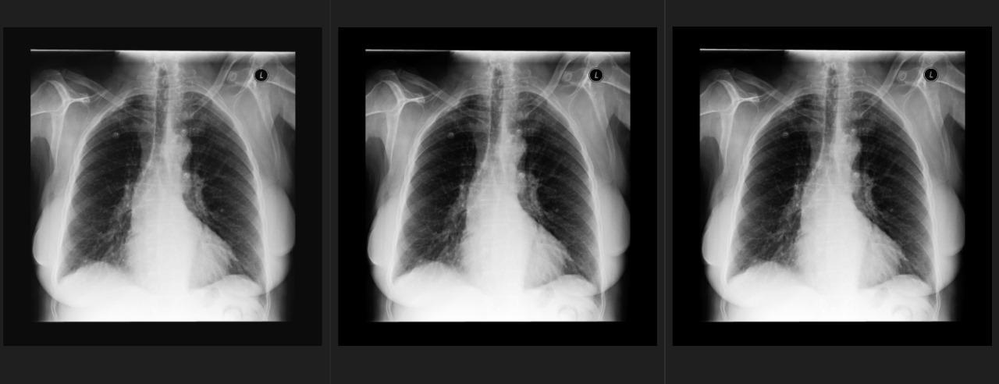
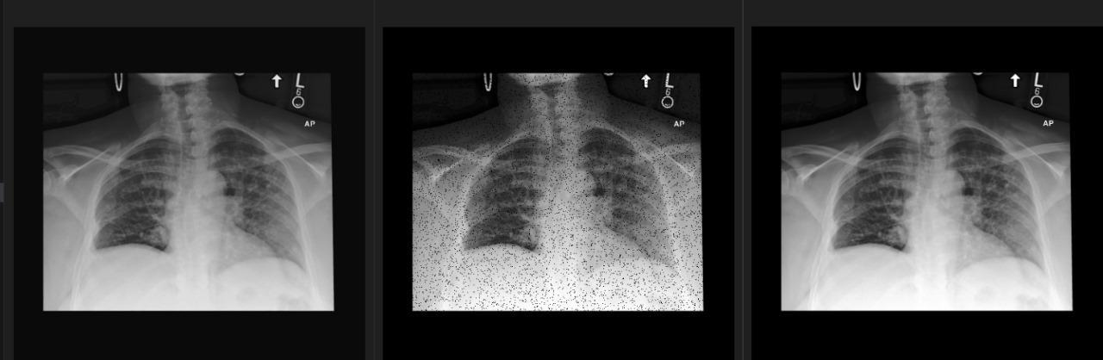
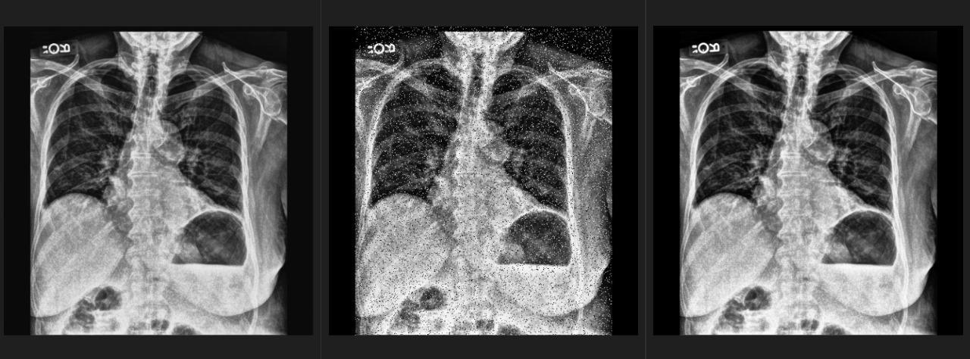
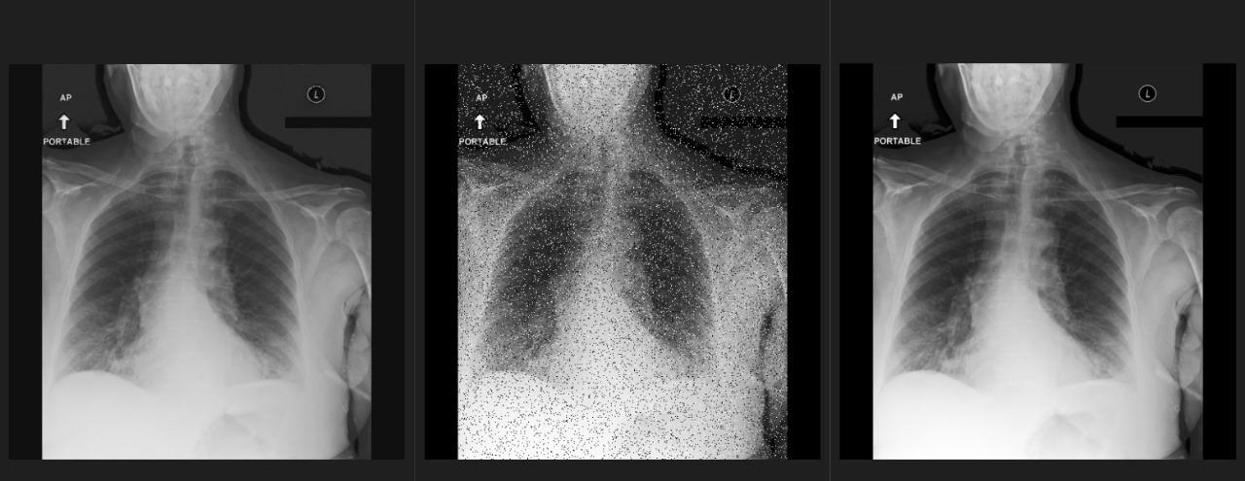
X-Reporto
Denoiser
Deep Learning Approach
Results
Result images Noised images Target images
Result images Noised images Target images

Slide 22
X-Reporto
Denoiser
Deep Learning Approach
Results
Size | 10000 | 20000
Data Split | Validation | Testing
SSIM | 71.5 | 78.48
PSNR | 25.4 | 28.55

Slide 23
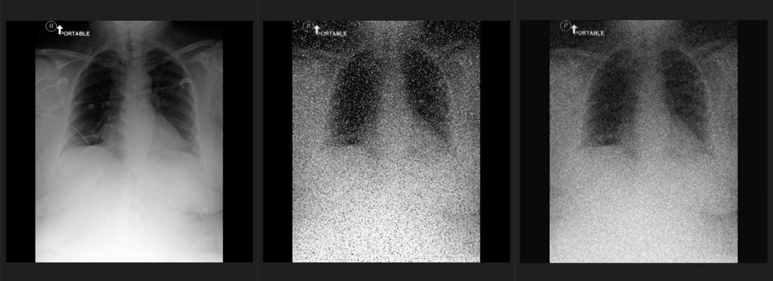
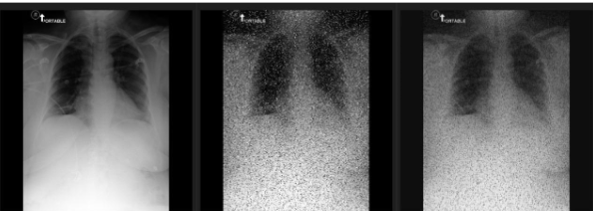
X-Reporto
Denoiser
Deep Learning Approach
Future Work
Target images Noised images Result images
Noise type: convolve noise, salt and pepper noise, gaussian projection noise PSNR: 21.79
Noise type: block pixel noise, salt and pepper noise, convolve noise PSNR: 21.39
Mix types of noise and train modules on data to handle many types of defects.

Slide 24
X-Reporto
Object Detector

Slide 25
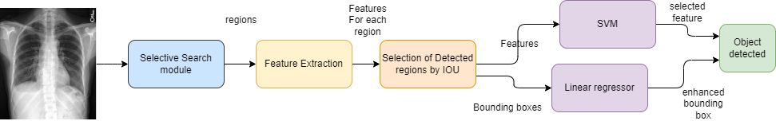
X-Reporto
Object Detector
Classical Approach
Block Diagram

Slide 26
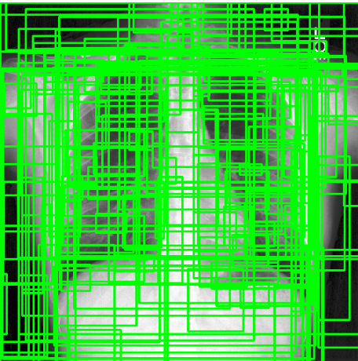
X-Reporto
Object Detector
Classical Approach
Region Proposals (Selective Search)
From set of regions, choose two that are most similar.
Combine them into a single, larger region.

Slide 27
X-Reporto
Object Detector
Classical Approach
Feature Extraction
HAAR
extracted from rectangular areas in an image.
HOG
Invariant to geometric transformations and lighting variations helps in analyzing the wide variability encountered in real-world medical image

Slide 28
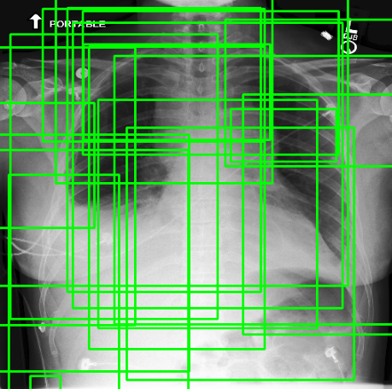
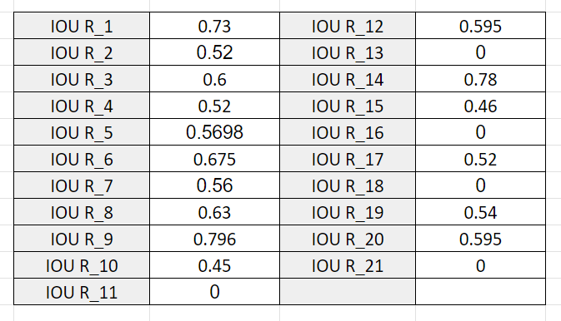
X-Reporto
Object Detector
Classical Approach
Results

Slide 29
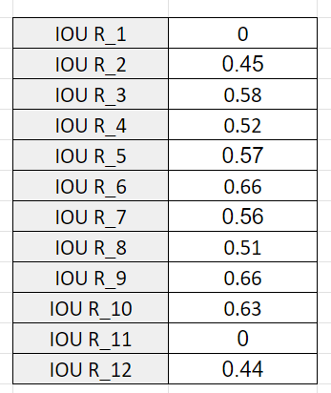
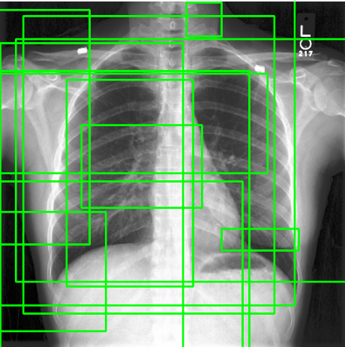
X-Reporto
Object Detector
Classical Approach
Results

Slide 30
X-Reporto
Object Detector
Deep Learning Approach
Preprocessing
Backbone
Anchor Boxes
RPN
ROI
Training
Evaluation

Slide 31
X-Reporto
Object Detector
Deep Learning Approach
Preprocessing
Resize
Padding
Data Augmentation
Rotation
Gaussian Noise.

Slide 32
X-Reporto
Object Detector
Deep Learning Approach
Backbone
ResNet50 ⇒ High Batch Size
Vgg-19
Anchor Boxes & PRN
Train over all data to get Best Boxes
Return losses and features even we have targets

Slide 33
X-Reporto
Object Detector
Deep Learning Approach
ROI
Guarantee generate 29 unique region even if these region has less losses

Slide 34
X-Reporto
Object Detector
Deep Learning Approach
Training
Backbone & RPN
ROI
All model
High batch size local ⇒ accumulative gradient

Slide 35
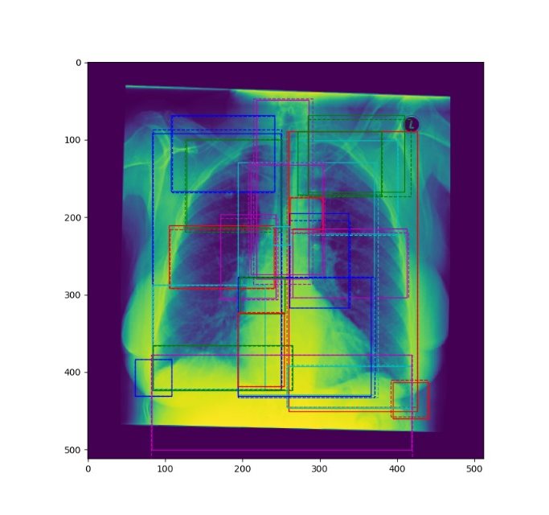
X-Reporto
Object Detector
Deep Learning Approach
Results
F1-Score ⇒ 97%
IOU ⇒ 90%

Slide 36
X-Reporto
Classifier

Slide 37
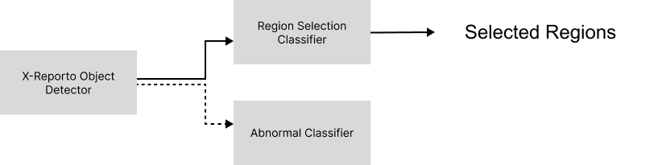
X-Reporto
Classifiers
Region Selection Classifier:
Select Out of 29 Anatomical Regions
Abnormal Classifier:
During Training only
Enhance Visual Features of Regions

Slide 38
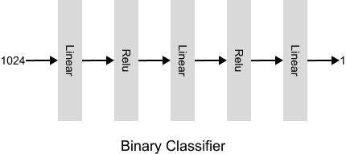
X-Reporto
Classifiers
Architecture Design
Linear + Relu Layer
1024 Visual Feature for Regions

Slide 39

X-Reporto
Language Model

Slide 40
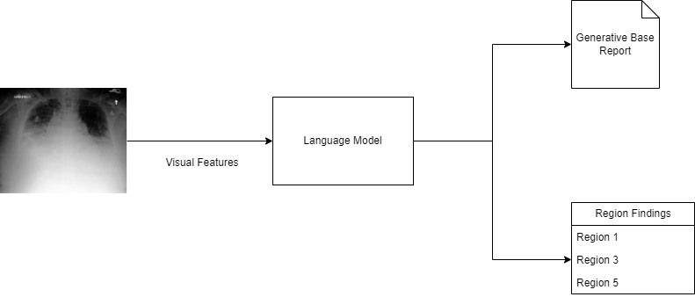
X-Reporto
Language Model
Block Diagram

Slide 41
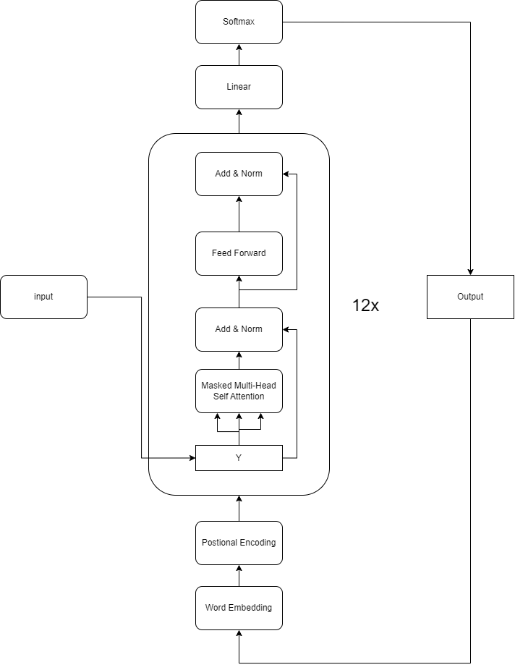
X-Reporto
Language Model
Block Diagram

Slide 42
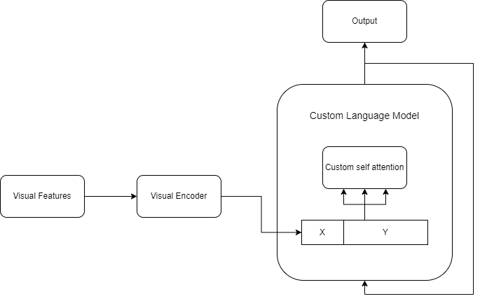
X-Reporto
Language Model
Block Diagram

Slide 43
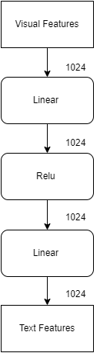
X-Reporto
Language Model
Visual Encoder

Slide 44
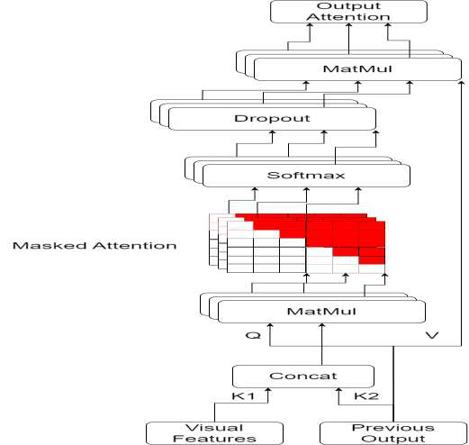
X-Reporto
Language Model
Attention Mechanism

Slide 45
X-Reporto
Language Model
Training Challenges
Memory constraints with batch size and sentence examples.
Solution: Gradient checkpointing to reduce memory usage.
Applied on each layer block of 12 layers in Language Model.
Gradient Checkpointing
Stores only inputs and outputs of each block.
Reduces memory requirements significantly.
Doubles training time due to recomputation of omitted activations.

Slide 46
X-Reporto
Language Model
Prediction Process
Sequential word prediction based on visual features.
Uses encoded visual features, word embeddings, and positional encodings and start of sentence.
Decoding Strategies
Greedy Search.
Beam Search.

Slide 47
X-Reporto
Language Model
Decoding Strategies (Greedy Search)
Selects the most probable word at each step.
May lead to less coherent reports.
Decoding Strategies (Beam Search)
Explores multiple word sequences.
Keeps top-k most likely sequences (k=6).
More coherent and accurate reports.

Slide 48
X-Reporto
Language Model
Filtering Sentences
Redundant Sentences
Problem: Overlapping regions cause redundant descriptions.
Software Solution: String matching to remove duplicates (ineffective for slight differences).
AI Solution:
Use word embeddings to filter similar sentences.
Roberta model scores sentence equivalence (-1 to 1).
Remove shorter duplicates (score > 0.9).

Slide 49
X-Reporto
Language Model
Filtering Sentences
Model Hallucination
Problem: Nonsensical or irrelevant output.
Solution:
Regex to detect and remove meaningless sentences.
Example: r"(.)\1{2,}" to match words with repeated characters.

Slide 50

X-Reporto
Template Based Report

Slide 51
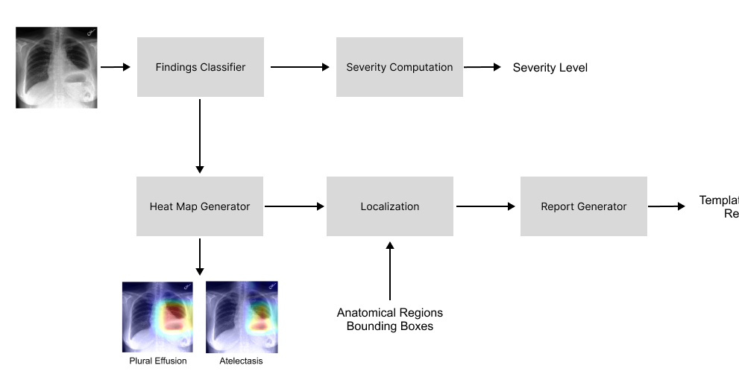
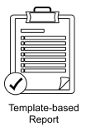
X-Reporto
Template Based Report
Pipeline
Output
Template Based Report
Findings Localization
Maps

Slide 52
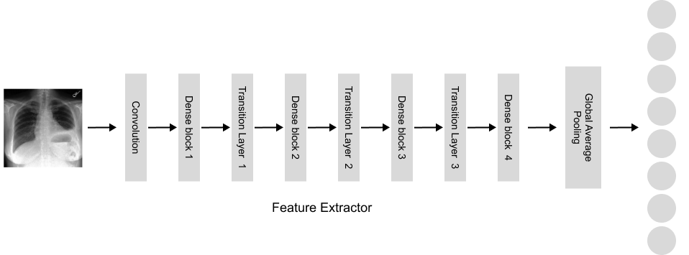
X-Reporto
Template Based Report
Findings Classifier
Architecture Design
Backbone
Global Average Pooling
Multi Label

Slide 53


X-Reporto
Template Based Report
No More AI
Let’s use our Engineering Skills

Slide 54

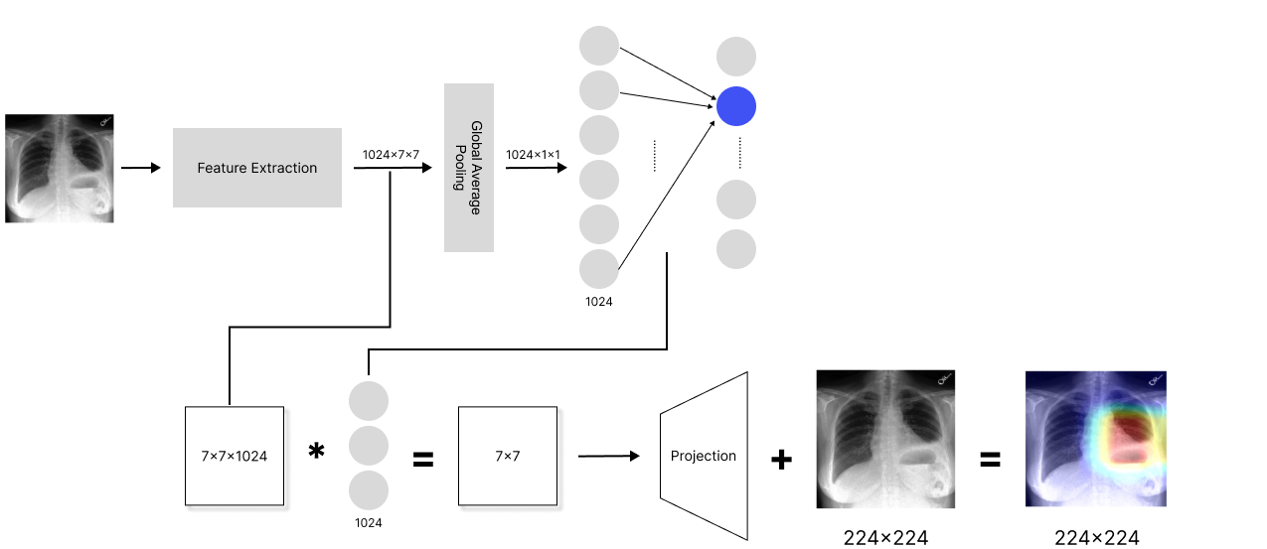
X-Reporto
Template Based Report
Heat Map Generator

Slide 55
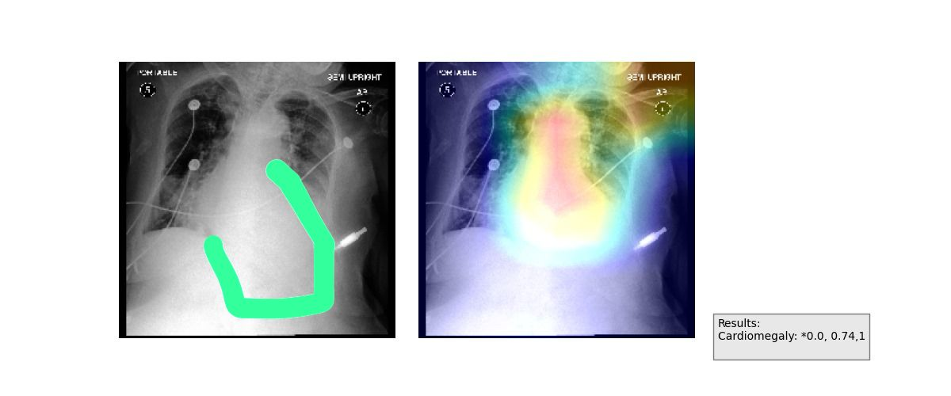

X-Reporto
Template Based Report
Heat Map Generator

Slide 56
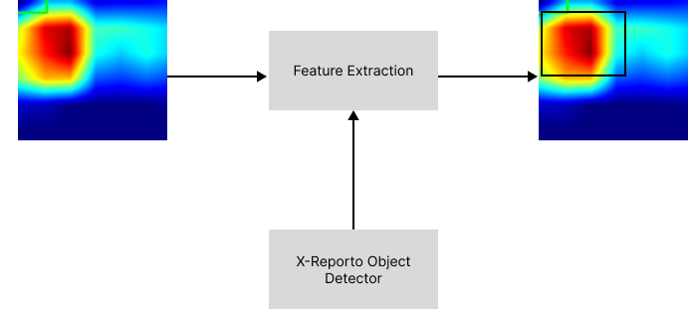
X-Reporto
Template Based Report
Localization
Output
Max Overlap with BB

Slide 57
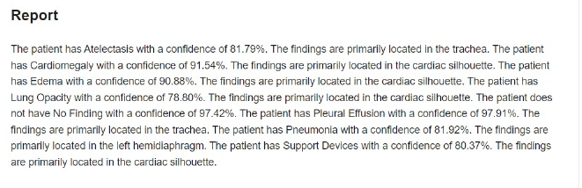
X-Reporto
Template Based Report
Report
Localization
Classifier Output

Slide 58
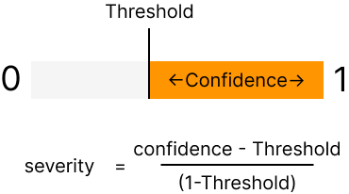
X-Reporto
Template Based Report
Severity
More Confidence ⇒ More Severe

Slide 59
X-Reporto
System Design

Slide 60
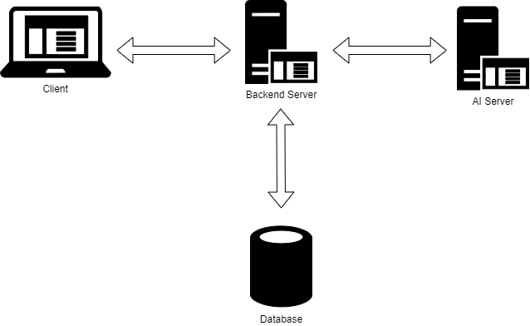
X-Reporto
System Design

Slide 61
System Components
Backend Server:
Acts as intermediary between client and other servers.
Uses REST APIs for client requests, CRUD operations, complex queries, and Communicating with AI Server.
Database Server:
Manages data insertion, deletion, updating, and retrieval.
Ensures data integrity and efficient query execution.
Storing AI Results.
AI Server:
Processes medical images received from the backend server.
Generates diagnostic reports, labels, and heatmaps.
Sends results back to the backend server.

Slide 62
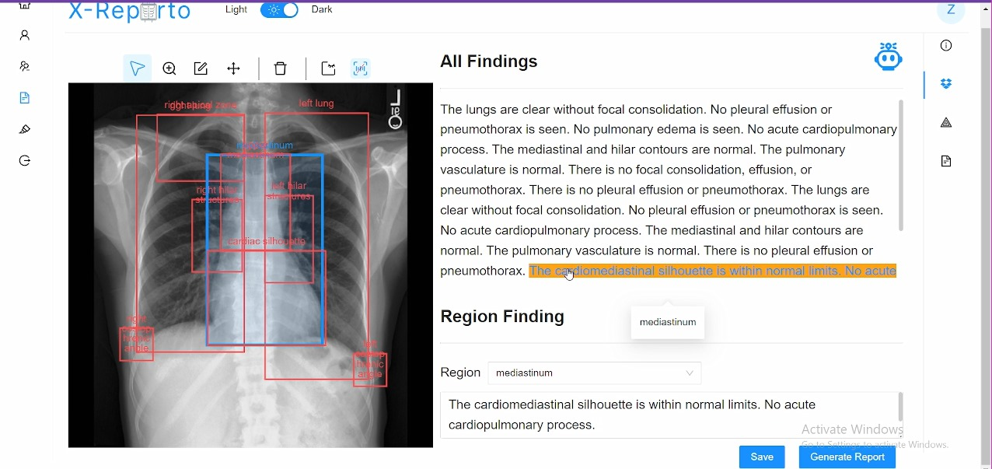
X-Reporto
X-Reporto Tool

Slide 63

X-Reporto
Demo
Let’s Try X-Reporto
Do you have your X-Ray??!

Slide 64

X-Reporto
Demo

Slide 65






X-Reporto
Our Tools

Slide 66
Model name | Work on | %Built in library
Data Preprocessing | Zeinab moawad | 0%
Denoiser ML | Ahmed Hosny | 0%
Denoiser DL | Ahmed Hosny - Zeinab moawad | 5%
Object detector ML | Zeinab moawad | 0%
Object detector DL | Ahmed Hosny | 20%
Classifiers | Basma Elhoseny | 5%
Language Model | Ahmed Sabry | 5%
Template base report & Heatmap | Basma Elhoseny | 5%
Backend | Ahmed Sabry | 10%
Front end | Ahmed Hosny - Zeinab Moawad - Basma Elhoseny | 10%
Packaging | Basma Elhoseny - Ahmed Sabry | 5%

Slide 67

X-Reporto
Thank
You.
Waiting for your Feedback :D

Slide 68
X-Reporto
Appendix

